Slide 1
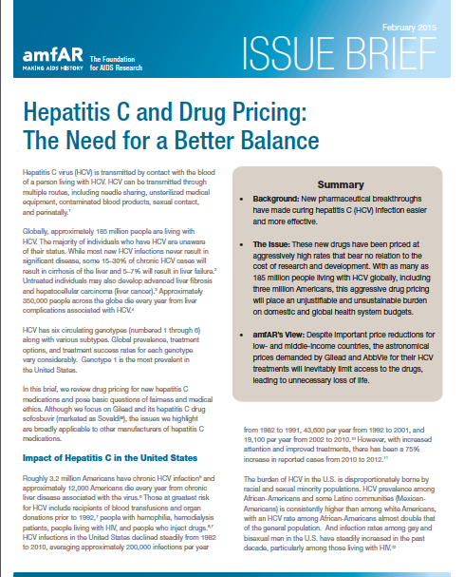
amfAR Issue Brief on Hepatitis C Drug Pricing
Notes:
Background: New pharmaceutical breakthroughs have made curing hepatitis C (HCV) infection easier and more effective.
The Issue: These new drugs have been priced at aggressively high rates that bear no relation to the cost of research and development. With as many as 185 million people living with HCV globally, including three million Americans, this aggressive drug pricing will place an unjustifiable and unsustainable burden on domestic and global health system budgets.
amfAR’s View: Despite important price reductions for low- and middle-income countries, the astronomical prices demanded by Gilead and AbbVie for their HCV treatments will inevitably limit access to the drugs, leading to unnecessary loss of life.

Slide 2
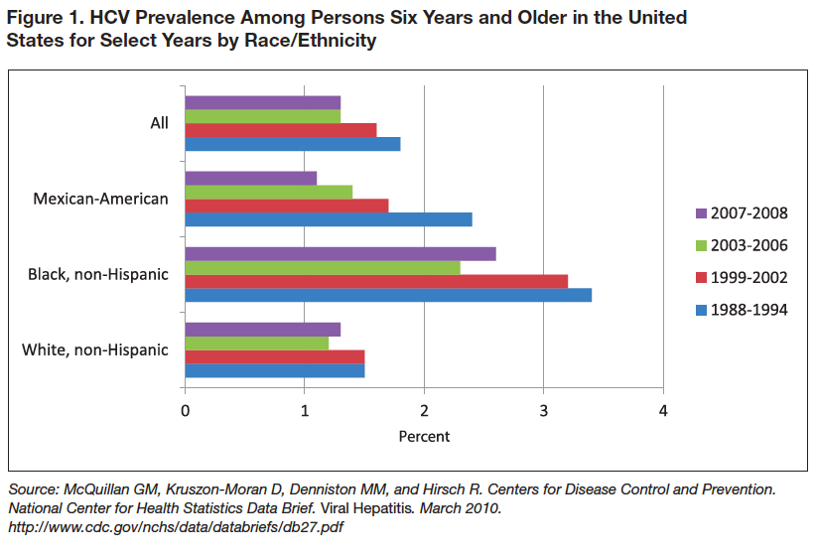
Notes:
Roughly 3.2 million Americans have chronic HCV infection and approximately 12,000 Americans die every year from chronic liver disease associated with the virus. Those at greatest risk for HCV include recipients of blood transfusions and organ donations prior to 1992, people with hemophilia, hemodialysis patients, people living with HIV, and people who inject drugs. HCV infections in the United States declined steadily from 1982 to 2010, averaging approximately 200,000 infections per year from 1982 to 1991, 43,600 per year from 1992 to 2001, and 19,100 per year from 2002 to 2010. However, there has been a 75% increase in reported cases from 2010 to 2012.
The burden of HCV in the U.S. is disproportionately borne by racial and sexual minority populations. HCV prevalence among African-Americans and some Latino communities (Mexican Americans) is consistently higher than among white Americans, with an HCV rate among African-Americans almost double that of the general population. And infection rates among gay and bisexual men in the U.S. have steadily increased in the past decade, particularly among those living with HIV.

Slide 3
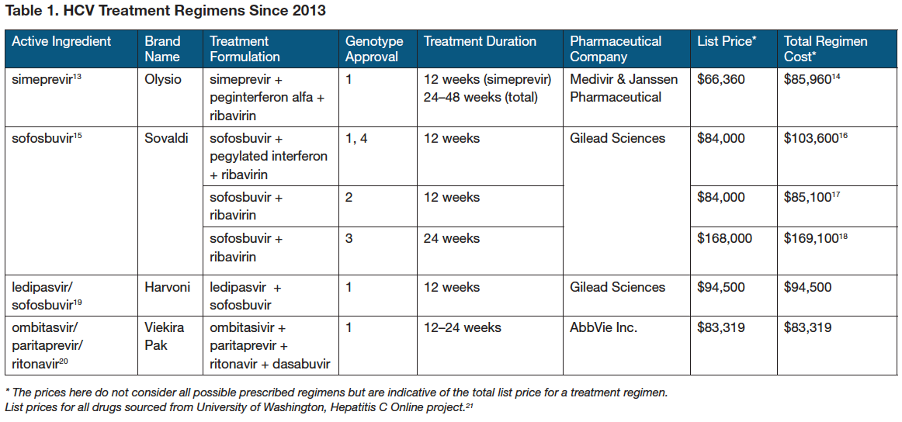
Notes:
The FDA has approved four new HCV treatment regimens since late 2013 (Table 1). While the new medications are welcome advances, they come with a hefty price tag. For example, sofosbuvir has been priced in the United States at $84,000 for a 12 week course of treatment. Such exorbitant price setting has once again brought the issue of drug pricing to the fore in the U.S. and around the world.

Slide 4
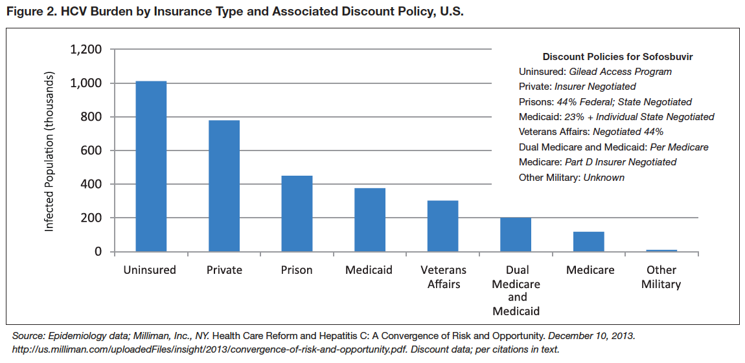
Notes:
Using just list prices, one estimate found that treating all HCV-infected individuals in the U.S. with sofosbuvir would cost more than $268 billion. However, virtually all providers get some sort of discount off the list price (Figure 2). But even taking these into account, the cost of treating all HCV-infected individuals in the U.S. would still be approximately $110 billion, a figure completely unrelated to the cost of developing the drug.

Slide 5
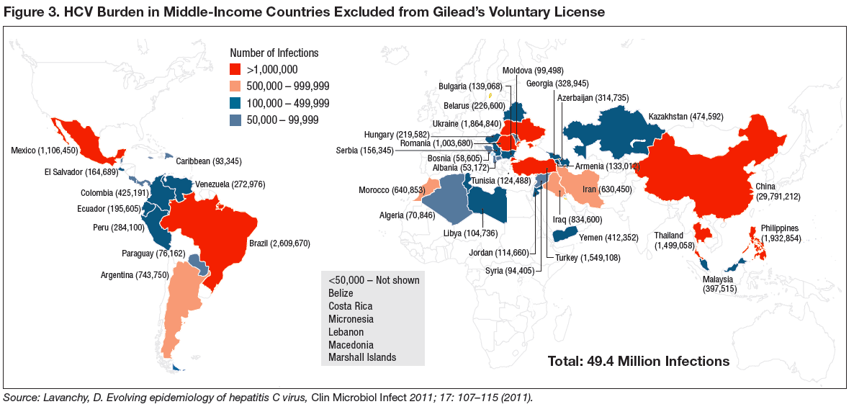
Notes:
Although voluntary licenses may reduce the cost of HCV medications in certain low-income countries, such medications may remain out of reach for those in middle-income countries not covered by the licenses. In particular, Gilead has not made clear the criteria it used to determine the geographic range of the agreement. The 91 countries included in the agreement account for all countries designated as low-income by the World Bank, 37 lower-middle-income, 17 upper-middle income, and two high-income countries, but exclude 13 lower middle-income and 38 upper-middle-income countries.
For countries left out of the agreement (Figure 3), the default rules established under the Agreement on Trade-Related Aspects of Intellectual Property Rights (TRIPS) are maintained. This means that Gilead retains the exclusive right to sell sofosbuvir in these countries without any generic competition. While few would argue that high-income countries should have been included, Gilead’s rationale for including Equatorial Guinea, for example, while excluding countries such as El Salvador or the Philippines has not been explained. Excluded lower- and upper-middle-income countries are estimated to have more than 49 million people with chronic HCV, including more than 29 million in China alone

Slide 6
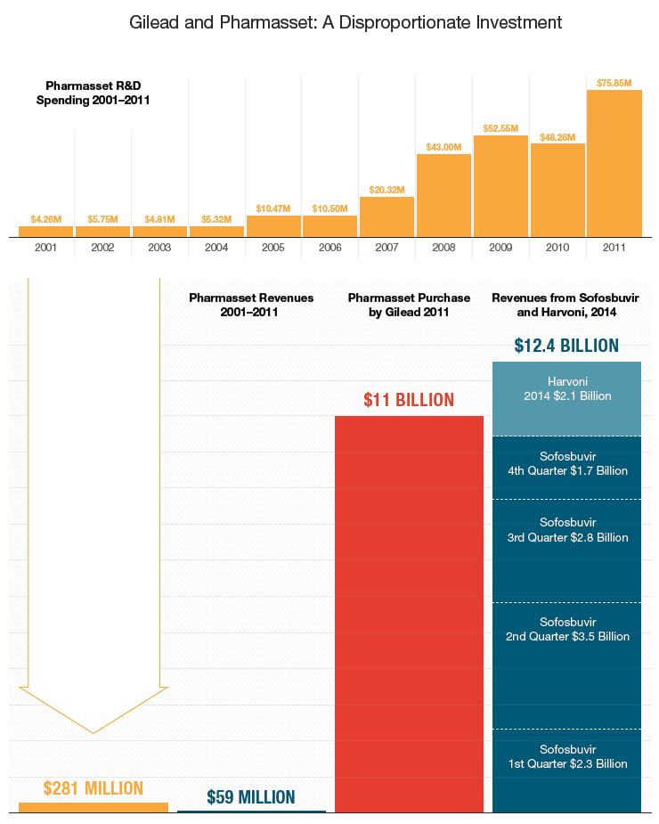
2014 Sales of Sofosbuvir Exceed Gilead’s Purchase of Pharmasset
Notes:
Gilead purchased a company Pharmasset for 11billion dollars for its New wonder drug (Sofosbuvir) Sovaldi
Only $281M went into the total research and development budget for all of its drugs, including Sofosbuvir
First year earnings of drug Sofosbuvir surpassed purchase price for Pharmasset
Pills were priced out of reach for most people w hep C ($1000 per pill or $84k for 12 week course of treatment)
The price for treatment is starting to decline due to competition from other drug companies, but the price of treatment is still out of reach for many

